Slide 1
A Masterclass in Reproducibility
Warwick University – Jan 2019
Dr Tom August

Slide 2
Introductions
Me
Computational Ecologist at the Centre for Ecology and Hydrology
10 years practical experience in reproducible research
You
Name
Course
Experience with R & Rstudio
What do you want to get out of the day

Slide 3
Course Aims
Know what reproducibility is
Know why reproducibility is important
Know how to implement reproducibility in your own work
You wont be an expert in reproducibility
This is a course about reproducibility not about R

Slide 4
Timetable

Slide 5
Course materials
Slides
Practical's
Other materials
All these are available online and we download them later
Much of this material is reproduced, using resources shared openly by others, notably Karl Broman, Coding Club, Hadley Wickham

Slide 6
Course style
There is going to be a mix of slides and practical
Things will start slide heavy and end practical heavy
This is informal, if you have a question shout it out
There are no stupid questions
You can catch me in the practical sessions
Practical are designed to help you learn
Work at your own pace, if you don’t finish it doesn’t matter
If you finish early help each other out
I’m hear to teach, not to solve IT issues
There is only one of me

Slide 7

A test of reproducibility
Notes:
Demonstrate how it is done
60 seconds to reproduce
What made it hard to reproduce
What could we have done to make it easier to reproduce?
These are themes we are going to come back to time and again
7

Slide 8
Some definitions
American Statistical Association
Reproducibility: A study is reproducible if you can take the original data and the computer code used to analyze the data and reproduce all of the numerical findings from the study.
Replicability: This is the act of repeating an entire study, independently of the original investigator without the use of original data (but generally using the same methods).
Other terms: Repeatable, Reusable, Correct

Slide 9
What are the hallmarks of reproducible research?
Analyses that are well documented
Files that are well organised
Processes that are coded, rather than carried out manually
Data that is easy to find and access
Edits and versions are easy to track

Slide 10
Why is reproducibility a good thing?
For us?
Your most frequent collaborator is your past self
Your work is more likely to be used by others if it is reproducible
You are more likely to avoid errors
You will save time in the long run (“Can you re-run this?”)
For ‘science’
It is easier to trust studies that are reproducible
Methods can be shared for effectively
Speeds up the scientific process

Slide 11
Why is reproducibility a good thing?
“To much fanfare, the journal Science published promising developments in stem cell research only to learn months later that the findings were bogus (1). Lancet editors retracted a paper on oral cancer when the editors learned that the researchers had fabricated their data (2). The New England Journal of Medicine published a statement of concern on a drug toxicity study when evidence suggested that the authors had withheld important adverse outcomes (3). Incidents of authors who have not disclosed potential conflicts of interest have prompted JAMA to reinforce its disclosure policies (4–6). Here at Annals, we retracted an article after learning that the lead author had fabricated the data. (7–9)” – Laine et al 2007

Slide 12
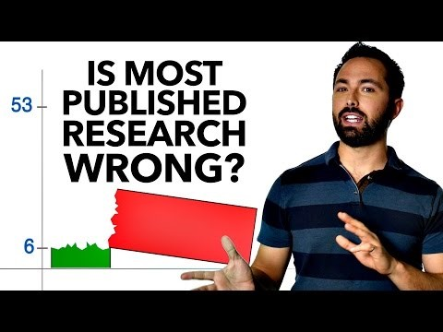

Slide 13
How do we make our research reproducible?
Order files and folders and track your edits
Git and Github
Code everything you do
R, Rstudio
Document as you go
Code commenting, Rmarkdown
Make your code reusable
R functions, R packages, Rmarkdown
Make your results easy to find
Shiny

Slide 14



You installed these… right?
Notes:
14

Slide 15
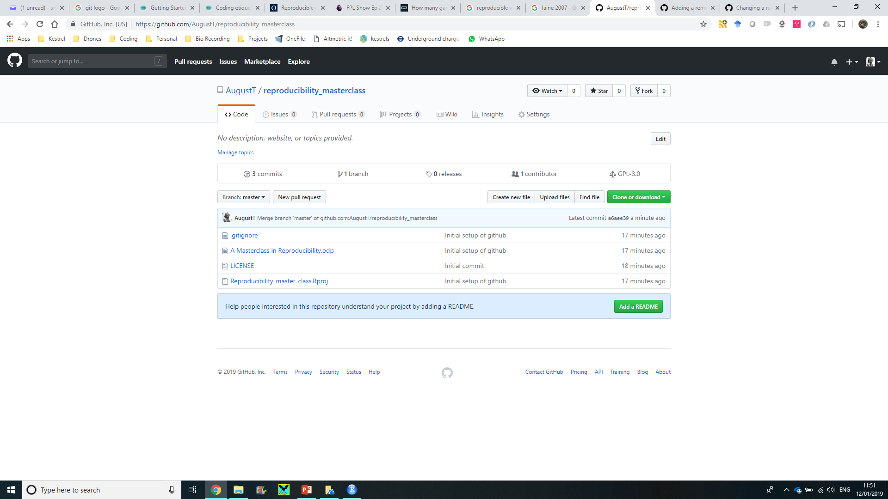
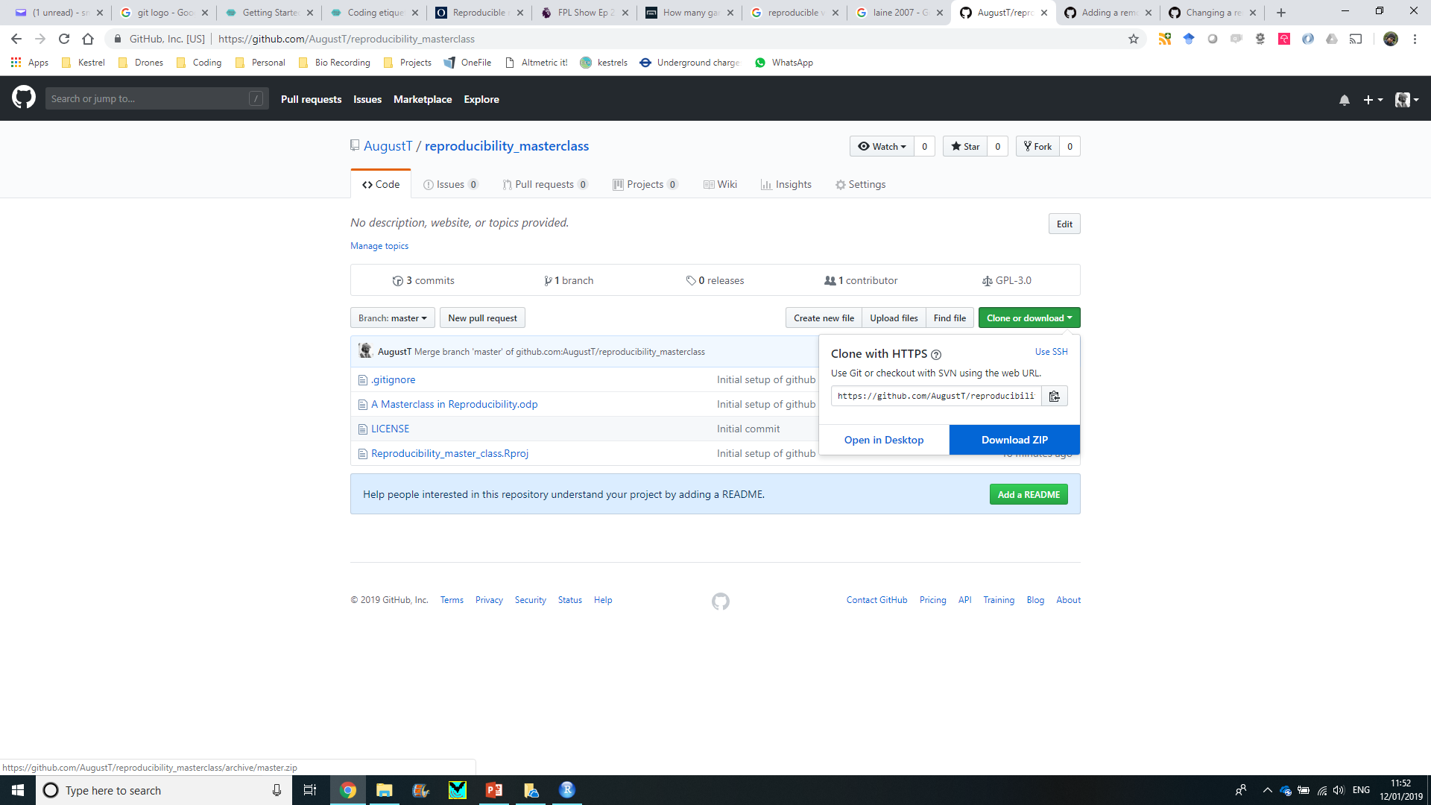
https://github.com/AugustT/reproducibility_masterclass

Slide 16
Files and folders

Slide 17
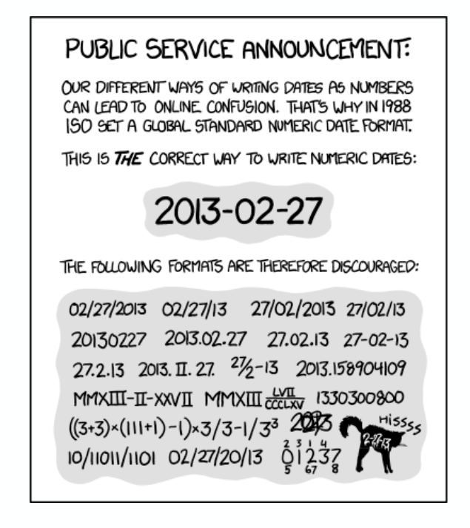
Good practise for organisation
Have one folder per project
Organise your files into folders. Typically I have:
Data
Code
Results
Name files clearly, they should be human-readable:
IJKGG.csv | Data.csv | Bat_data_2018.csv
Use plain text files where possible, avoid proprietary formats
Bat_data_2018.xlsx | Bat_data_2018.csv
Add dates to file names, especially data, think about order
Group_data_ 20190111.csv
Backup your work
Be consistent
XKCD

Slide 18
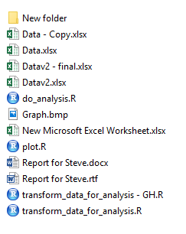
Practical
2_Files_and_folders\my research
5 minutes

Slide 19
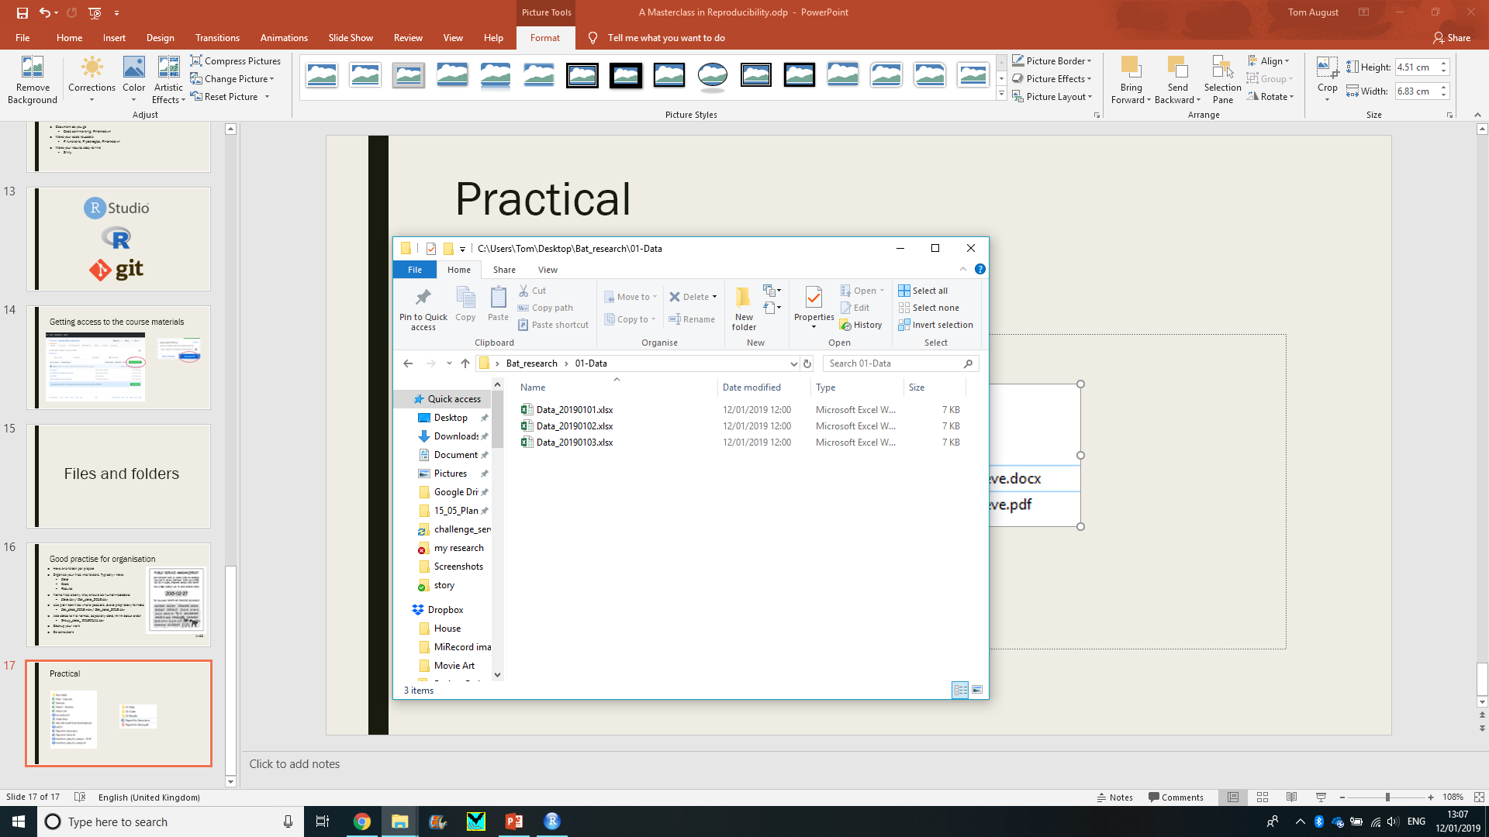
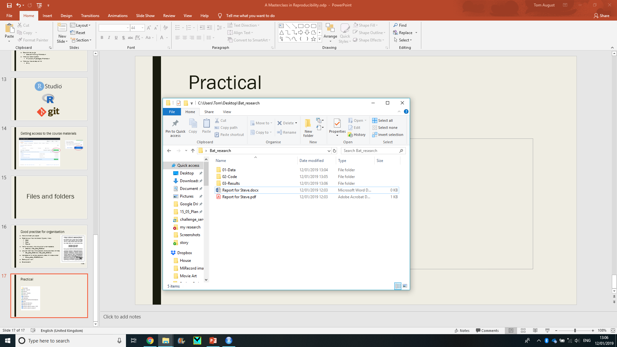
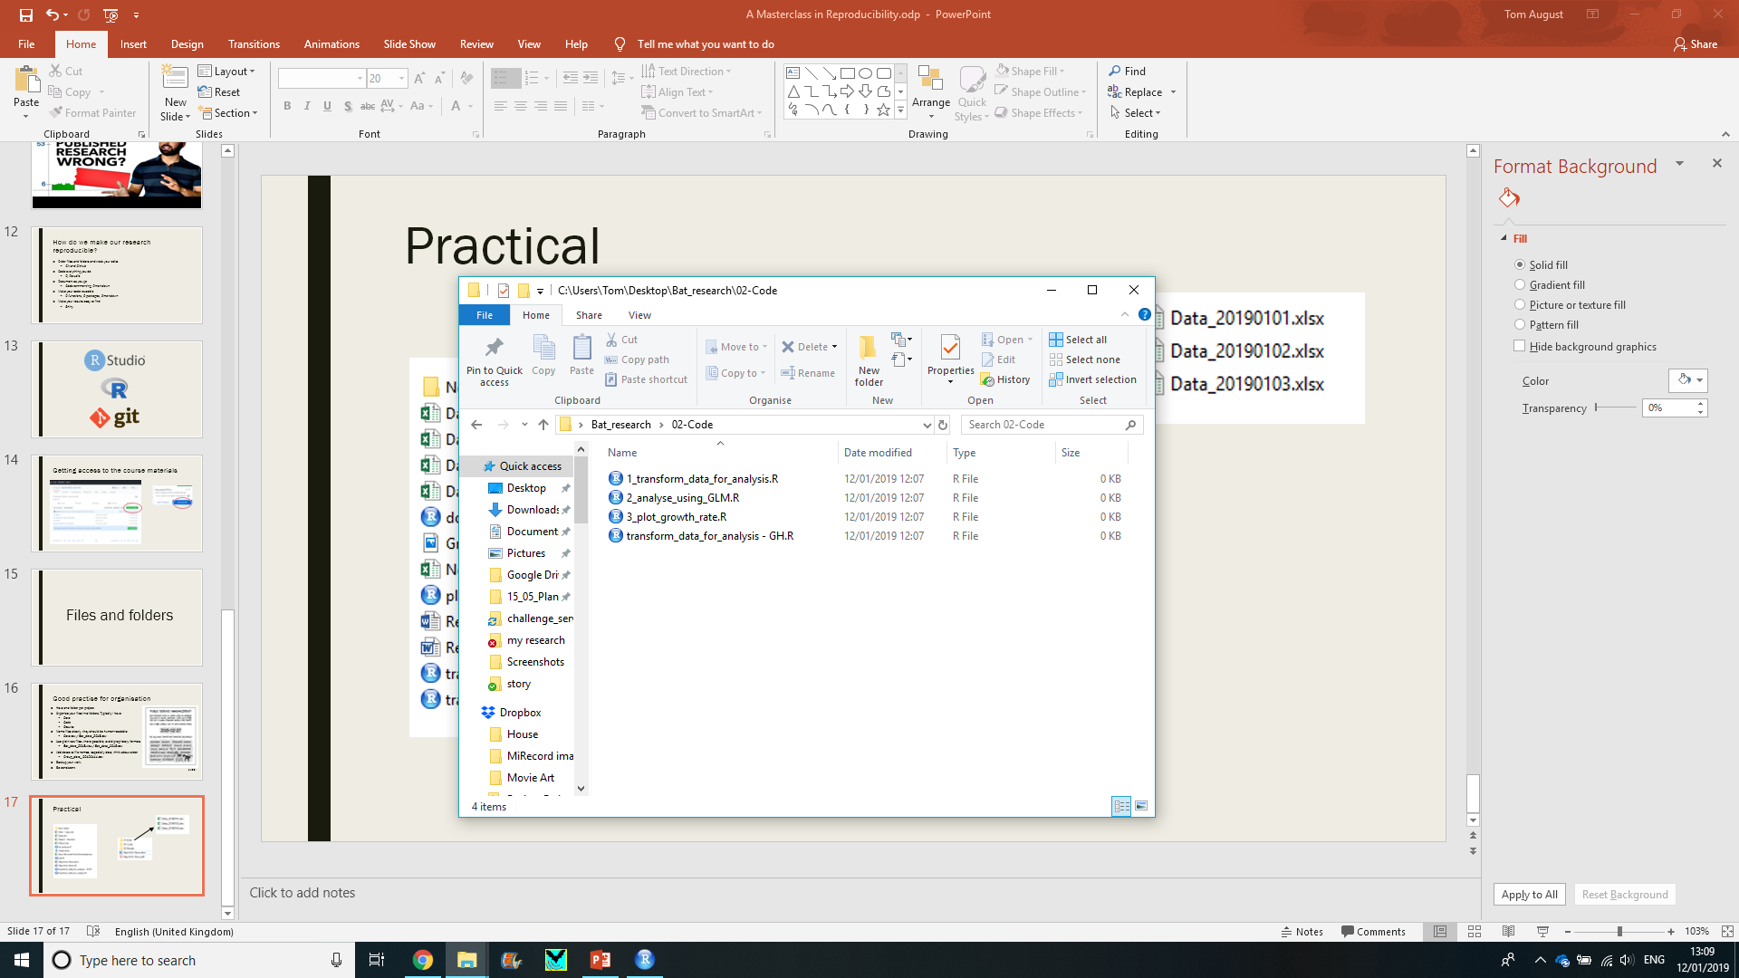
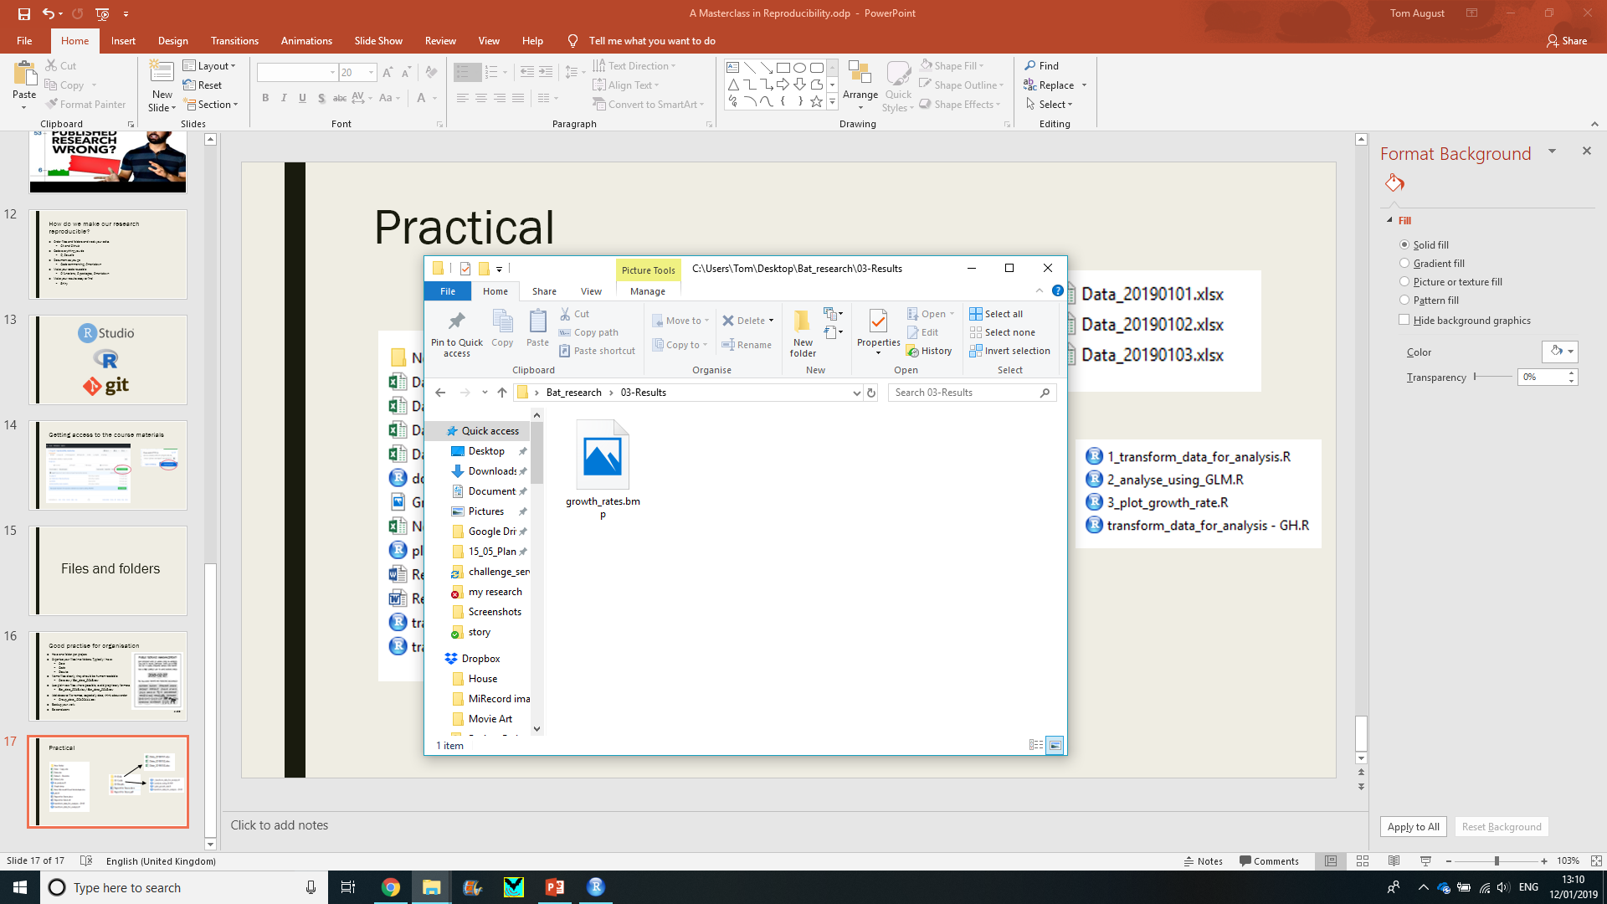
Practical

Slide 20
Coding etiquette

Slide 21
Coding etiquette
Code should be human readable
You want it to make self to others and yourself
Reading code should not give you a headache
It is worth taking a little extra time to make it easier to understand
A good resource: Hadley Wickham's R Style Guide
But… there are a number of different style guides out there and they do disagree quite a lot.

Slide 22
Coding etiquette
Variables store data and should be nouns [bat_counts], functions do things and should be verbs [mean].
Names should be short and descriptive with ‘_’ or CamelCase used to separate words in names.
You will find conflicting advise online and between programmers. Hadley Wickham doesn’t like CamelCase:
BAD
first_day_of_the_month
DayOne
dayone
djm1
GOOD
day_one
day_1

Slide 23
Coding etiquette
Use spaces in your code to make it easy to read and understand. You are not going to run out of space so don’t cram everything together.
average<-mean(feet/12+inches,na.rm=TRUE)
average <- mean(feet / 12 + inches, na.rm = TRUE)

Slide 24
Coding etiquette
When using loops or if statements in R You can end up with ‘nested’ code. Using indentation is key to making this easy to read.
if (y == 0) {
log(x)
} else {
if(x == 1){
y ^ x
} else {
x ^ y
}
}
if (y == 0) {
log(x)
} else {
if(x == 1){
y ^ x
} else {
x ^ y
}
}

Slide 25
Coding etiquette
Avoid long lines, that can make it harder to read your code.
My_data <- read.csv(path = ‘mydata.csv’, header = TRUE, sep = ‘,’, stringsAsFactors = FALSE)
My_data <- read.csv(path = ‘mydata.csv’,
header = TRUE,
sep = ‘,’,
stringsAsFactors = FALSE)

Slide 26
Coding etiquette
Clearly document what your code does, and break it into sections:
># Comments start with a ‘#’ and are ignored
># when you run your code
>
>X <- 1:10
># Average the values in X
>mean(X)

Slide 27
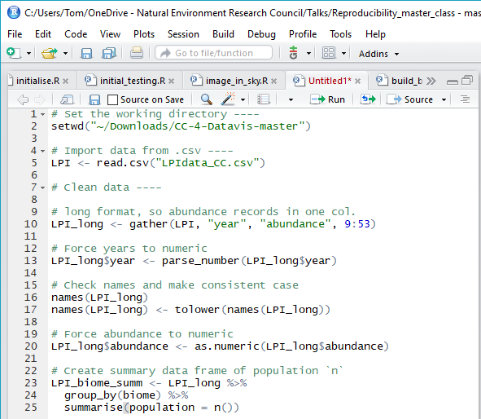
Coding etiquette
Clearly document what your code does.
How much is enough?
# Analysis of 2019 finances
# Tom August
# 2019-01-05
# 1. Load libraries
…
# 2. Load data
…
# 3. Reformat data
…
…
…
# 10. Save results
…

Slide 28
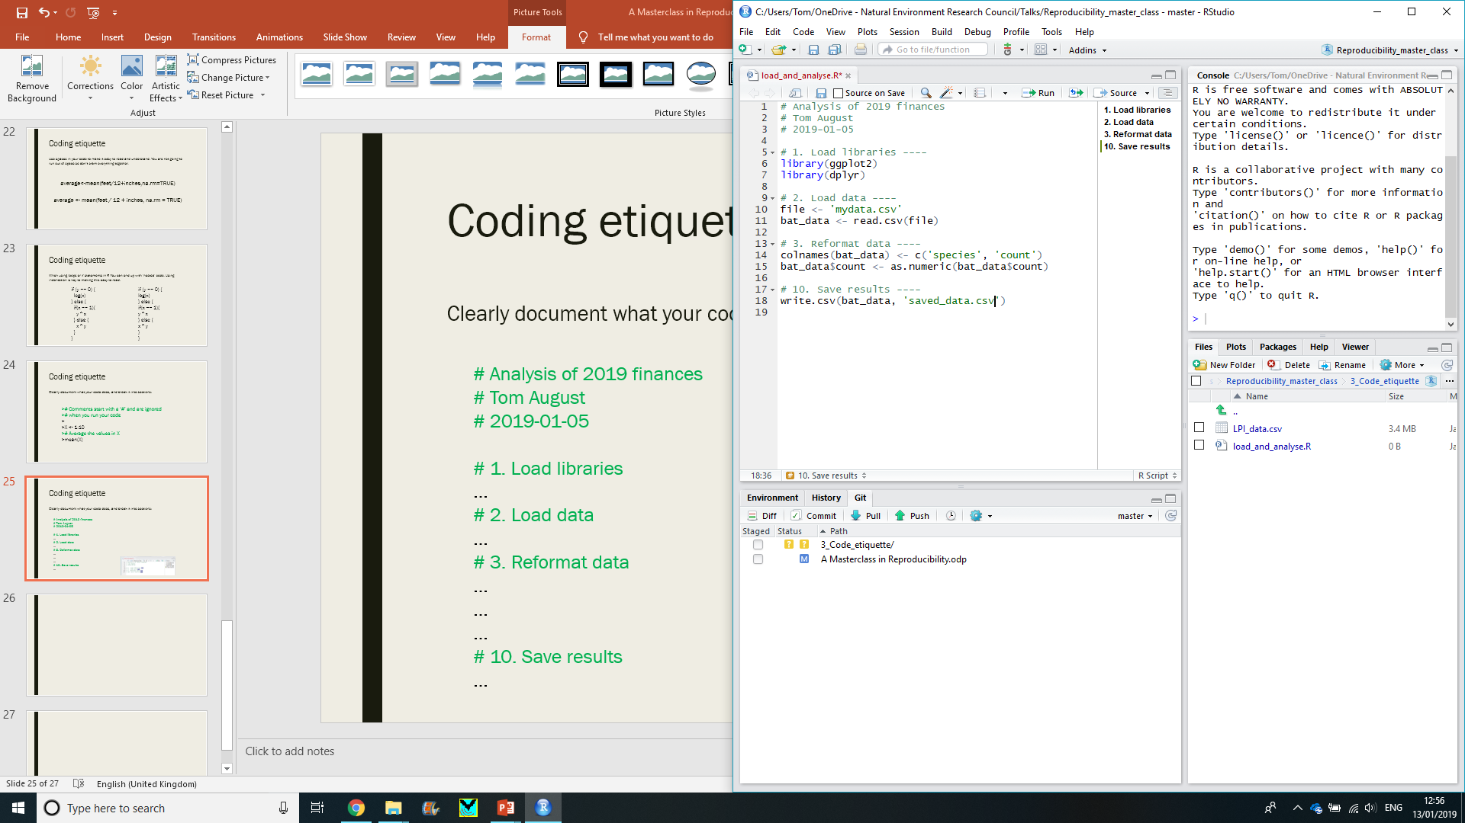
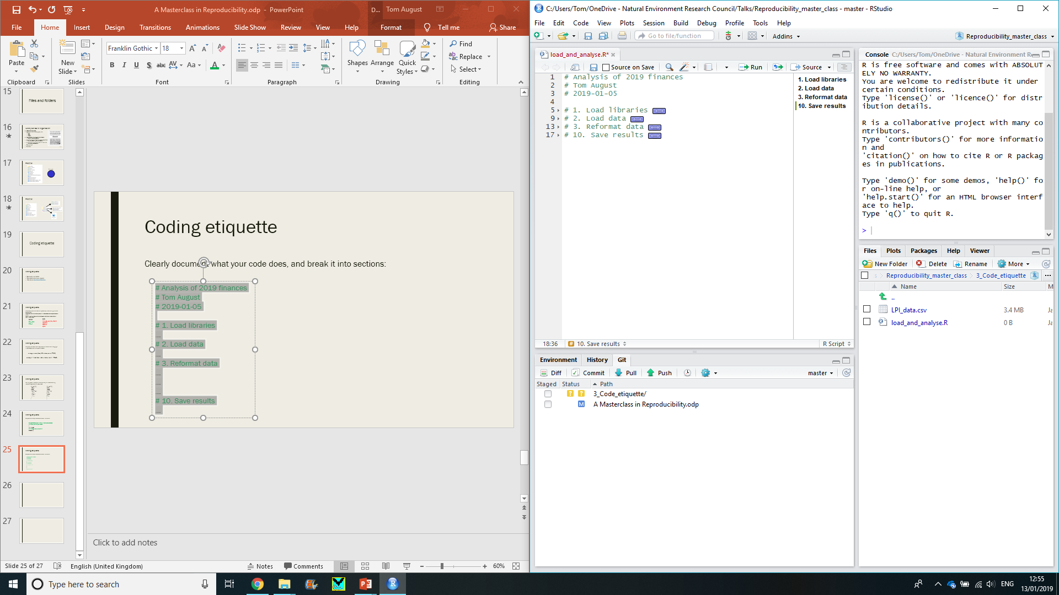
Coding etiquette
Rstudio has some features that can help you to keep organised

Slide 29
Cheatsheets

Slide 30
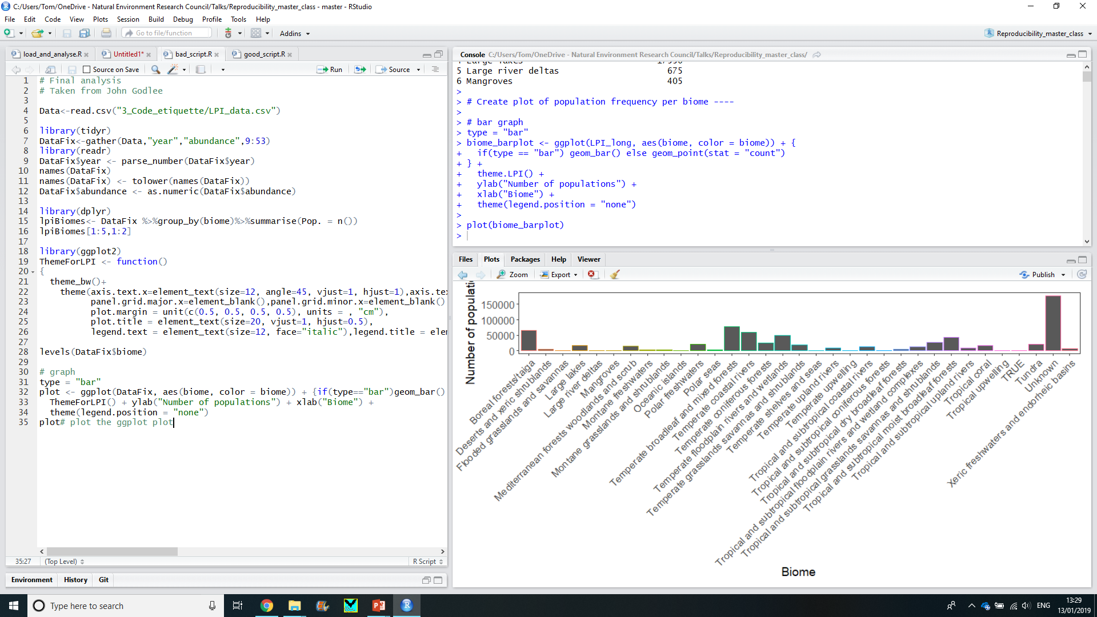
Practical
3_Code_etiquette\bad_script.R
Appropriate names
Spacing
Descriptive comments
Ordered sections
Avoid long lines
10 minutes

Slide 31
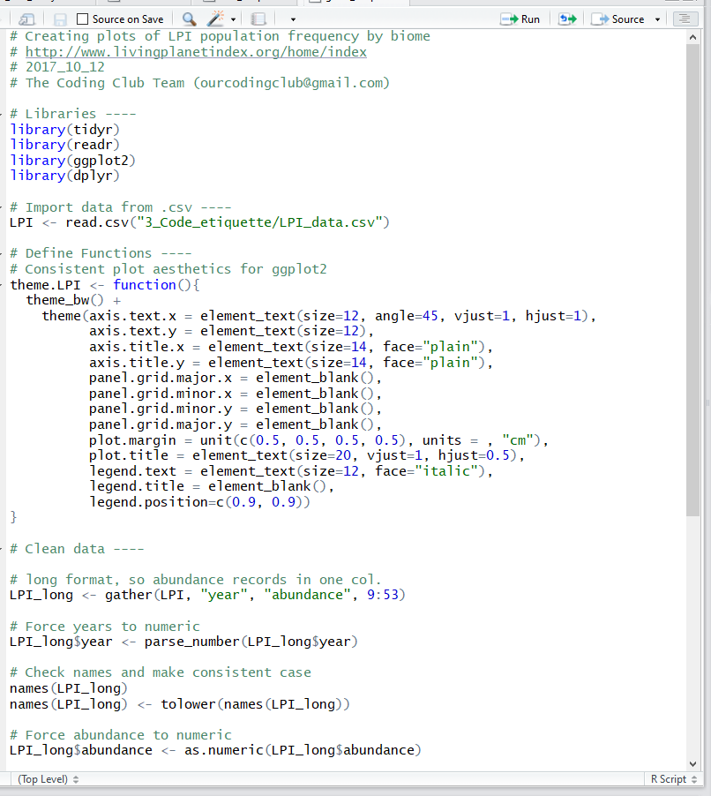
Practical

Slide 32
Functions, Packages & Unit tests (very briefly)

Slide 33
Functions
Functions are R commands that do things
Mean(), read.csv(), plot(), c()
Functions let you share functionality with others
It reduces the length of your scripts
They are faster
They will make you write better code
They are easier to share and will run consistently, making them more reproducible

Slide 34
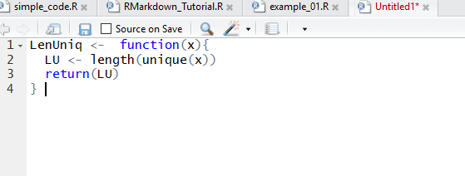
Functions
Name
Arguments
Returned object

Slide 35
Packages
Packages are collections of R functions that are connected by a common theme
They are easy to share
They are well documented, and often contain ‘vignettes’
‘Published’ packages are put on CRAN
Packages can also be shared via GitHub
Packages are not as hard to write as you might think
Having an R packages can help your reputation as a reproducible researcher
https://hilaryparker.com/2014/04/29/writing-an-r-package-from-scratch/

Slide 36
Unit tests
“UNIT TESTING is a level of software testing where individual units/ components of a software are tested. The purpose is to validate that each unit of the software performs as designed. A unit is the smallest testable part of any software. It usually has one or a few inputs and usually a single output.” - Google
How do you know your code works today, the same way as yesterday?
How do you know Hadley hasn’t broken your package?
How do you know if you need to make updates for the latest version of R?
Answer: Unit tests
http://r-pkgs.had.co.nz/tests.html

Slide 37
Licenses
I share an R package online. You want to use it in your research. Are you allowed to do that? Do you need to credit me?
Licenses dictate what you can and cannot do
The ensure people get credit
They protect your work financially
They can restrict what people can do with your code

Slide 38
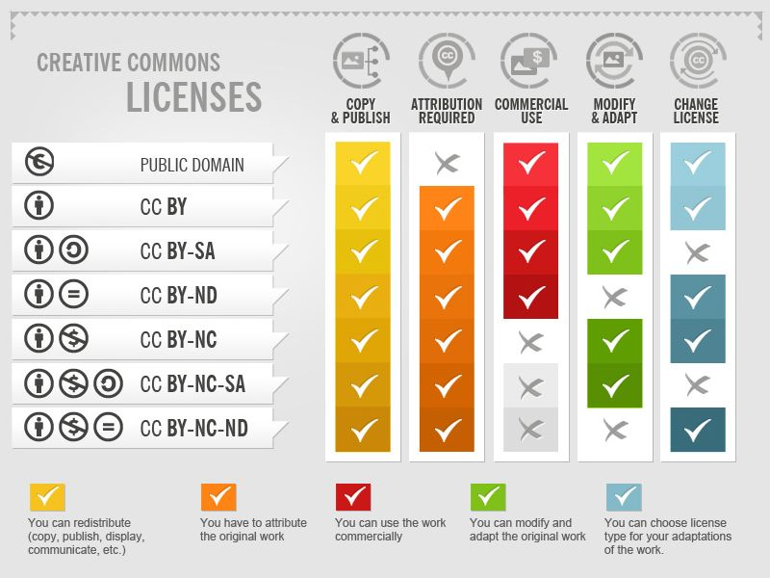
Licenses

Slide 39
R Markdown

Slide 40

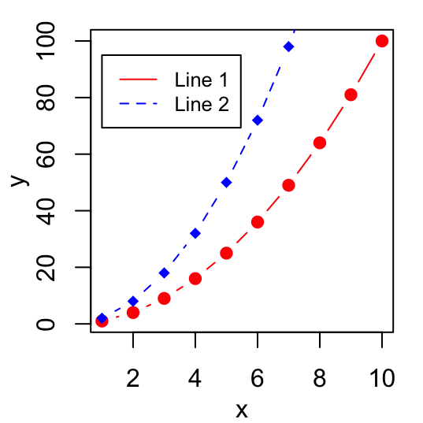
Creating reproducible documents
How do you share your code once complete?
Code
Figures
Documentation

Slide 41
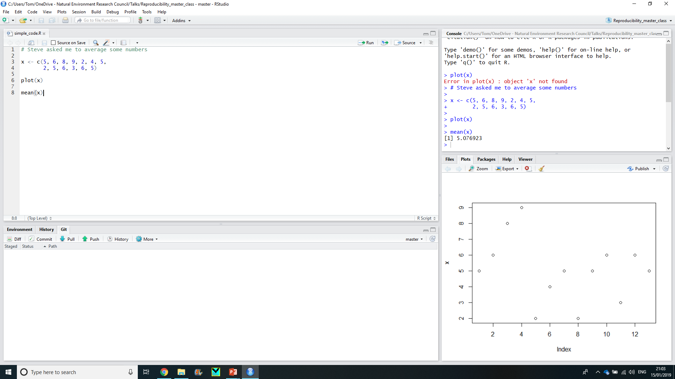
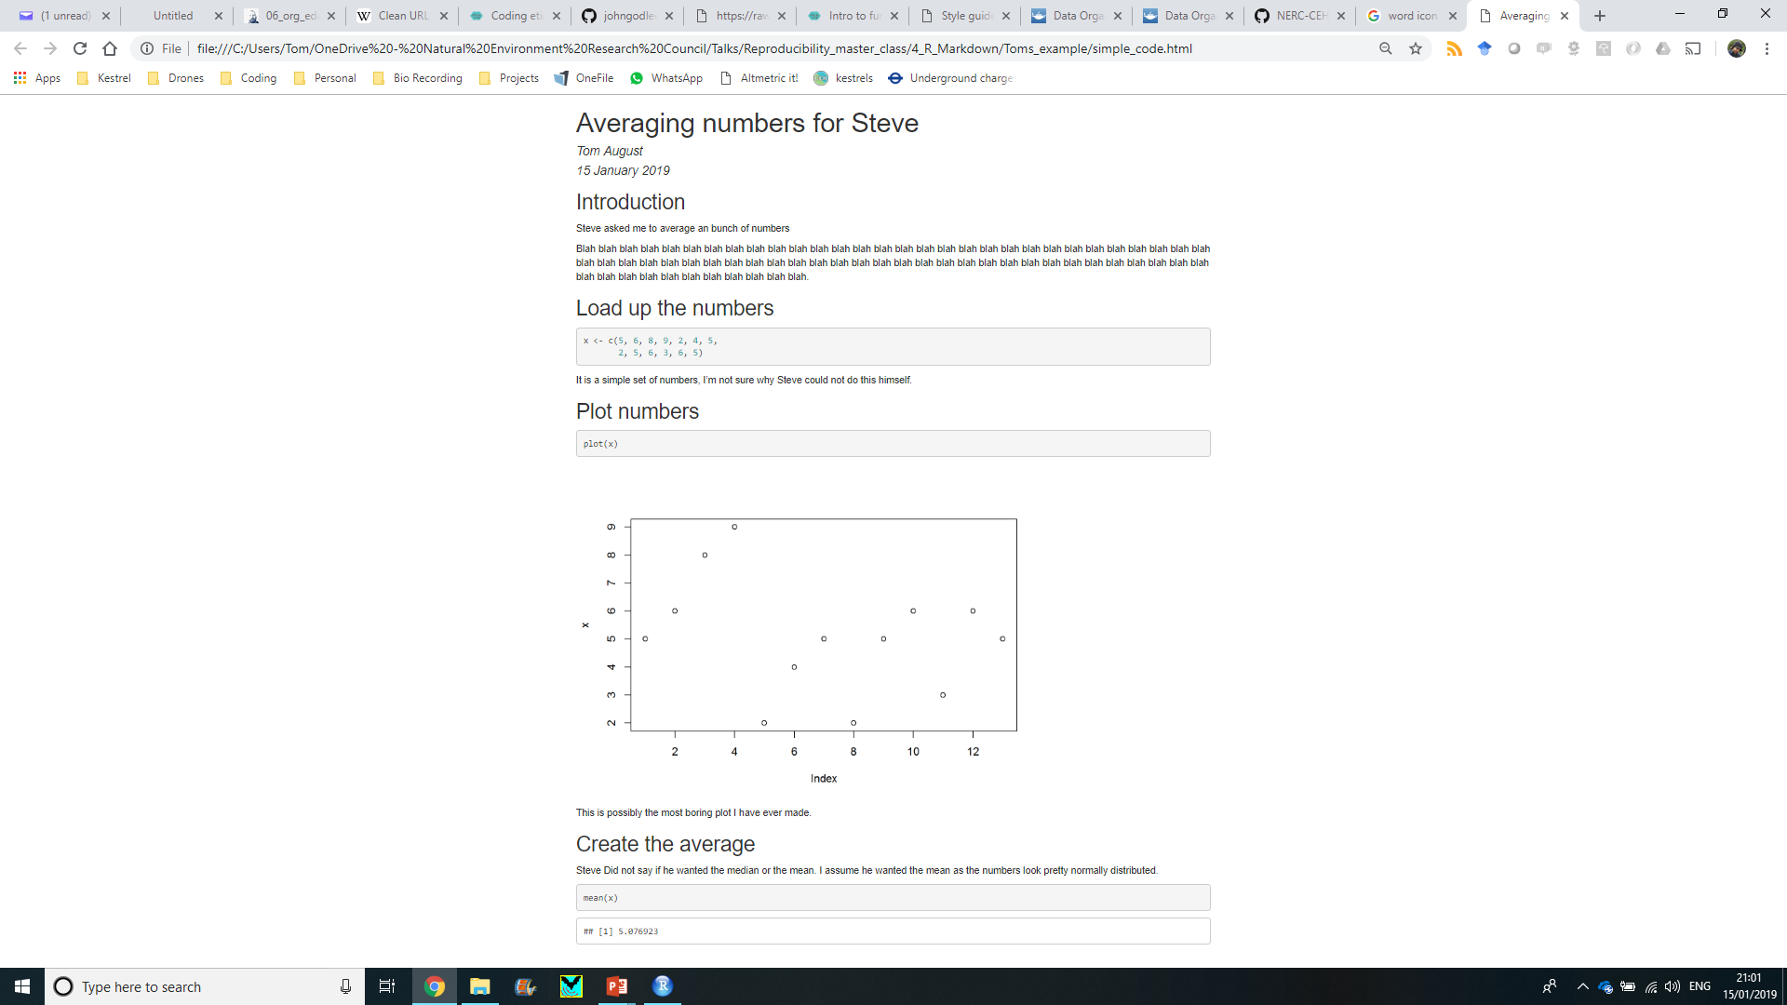
Creating reproducible documents

Slide 42
Creating reproducible documents
What are the advantages of R Markdown?
Ensure your work can be reproduced
Document your code as you go
Make edits and re-run your analysis, this can save a LOT of time
Enable others to re-use or change your work
Keeps code, documentation and results all in one place
It is fast becoming the new ‘norm’

Slide 43
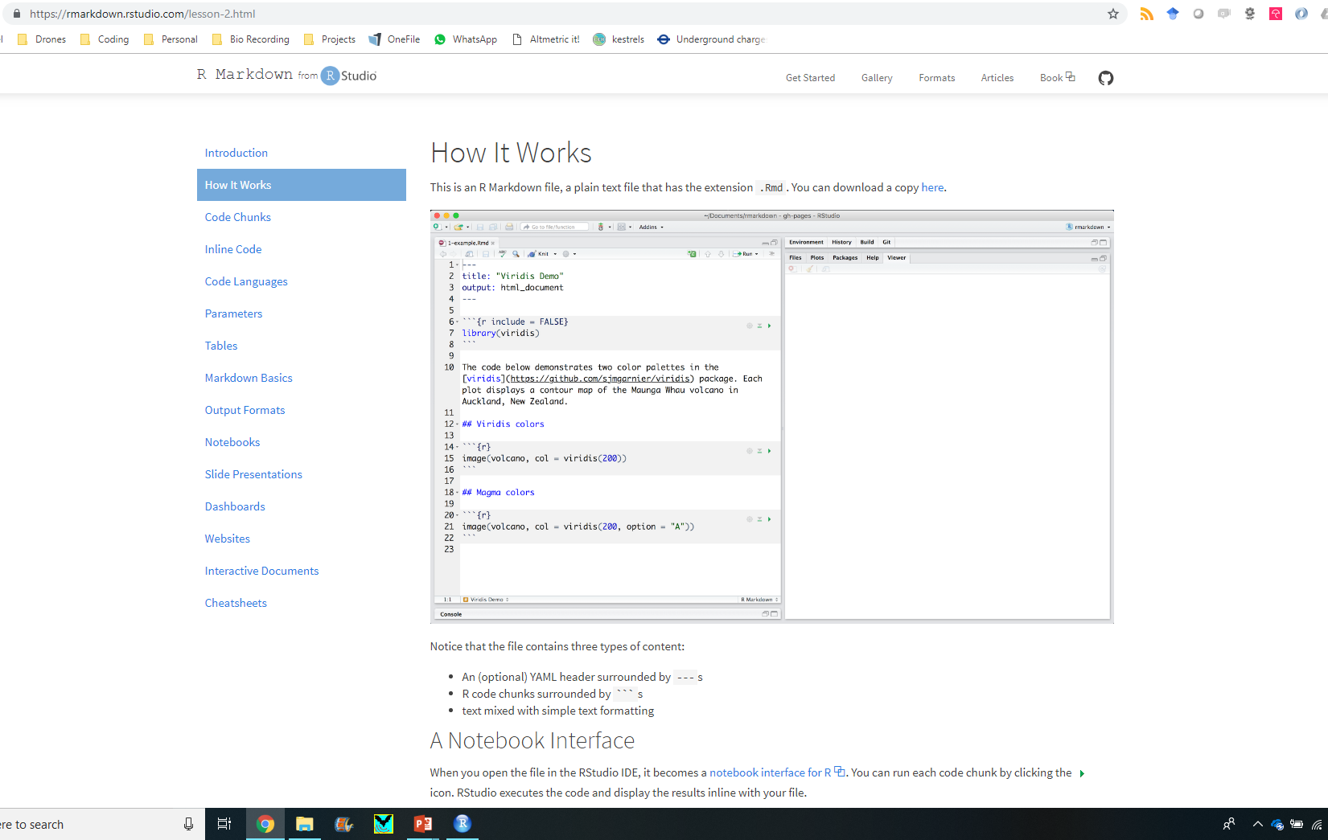
https://rmarkdown.rstudio.com/lesson-2.html

Slide 44
Cheatsheets

Slide 45
Practical
install.packages("rmarkdown")
library(rmarkdown)
Create an R Markdown file
Empty the contents (but keep the top bit)
Save it to the folder 4_R_Markdown

Slide 46
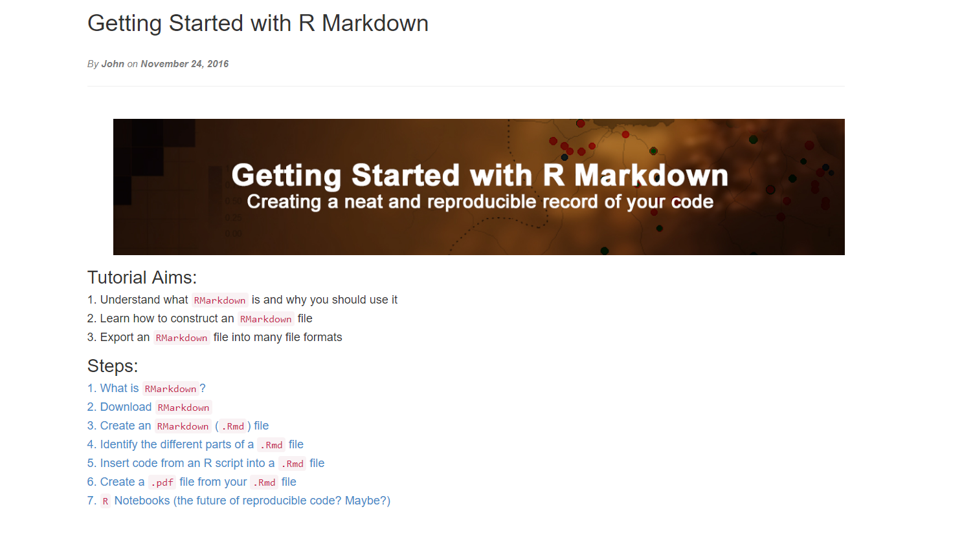
Google “Ourcodingclub Rmarkdown” and click the first link Start at section 4

Slide 47
Git and GitHub

Slide 48
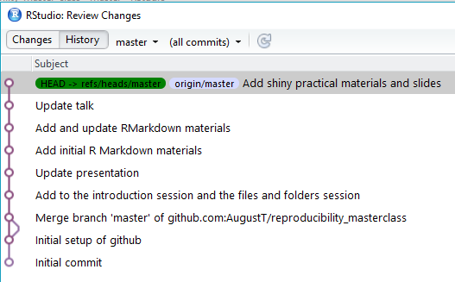
Version Control
Track changes to files
No more need for numbering your files
My_important_data.csv
My_important_data2.csv
My_important_data3.csv
My_important_data4.csv
‘This was working a couple of days ago…’
A Facebook timeline for your code
Named after Linus Torvalds
You installed this… right?

Slide 49

Version Control
Have you ever had to merge multiple comments to a document?
Tracking in Git makes merging comments easy
Github
Like Facebook, for programmes
… and a bit like dropbox
… and a bit like Google docs
Github makes code truly open
You can view all of the code and all of the history

Slide 50
Version Control
PULL
PUSH
PULL
PUSH
MERGE
Commit
Commit
Tom’s PC
Steve’s PC

Slide 51
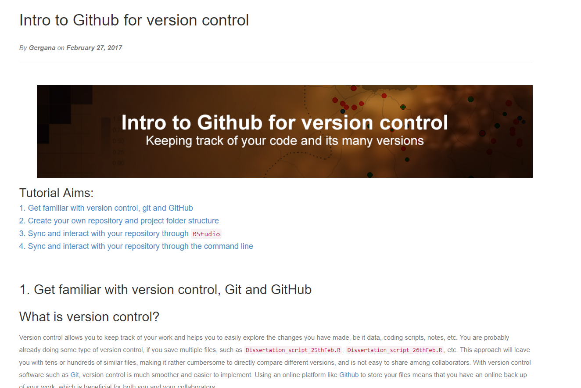
OurCodingClub > Tutorials > Github

Slide 52
Interactive websites using Shiny

Slide 53


How do you share your work once it is complete?
Papers
Presentations
Poster
Tweet
Code on Github
R-package on CRAN

Slide 54
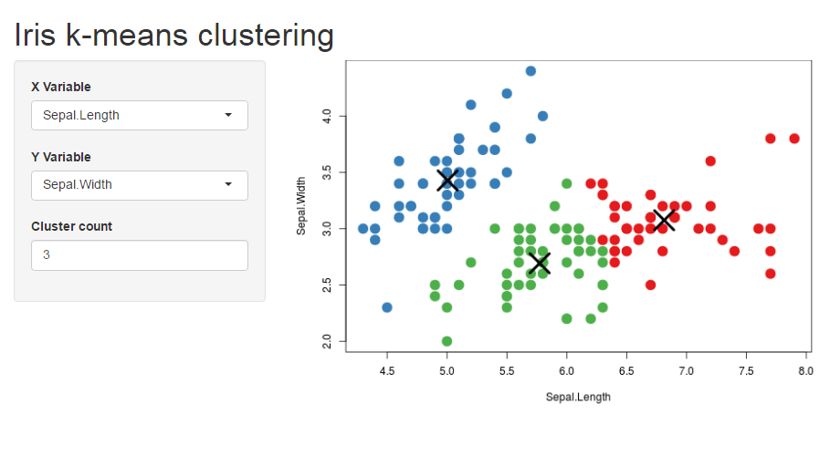
R shiny
Allows others to explore your data, or even use your methods, with out the need to know how to use R

Slide 55
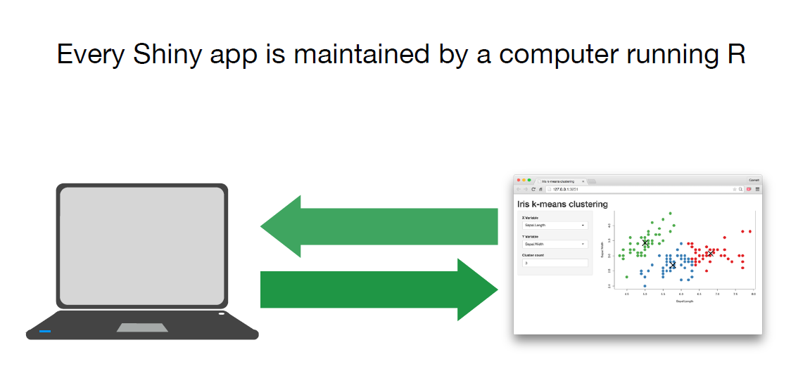
How does it work?
Server.R
UI.R

Slide 56
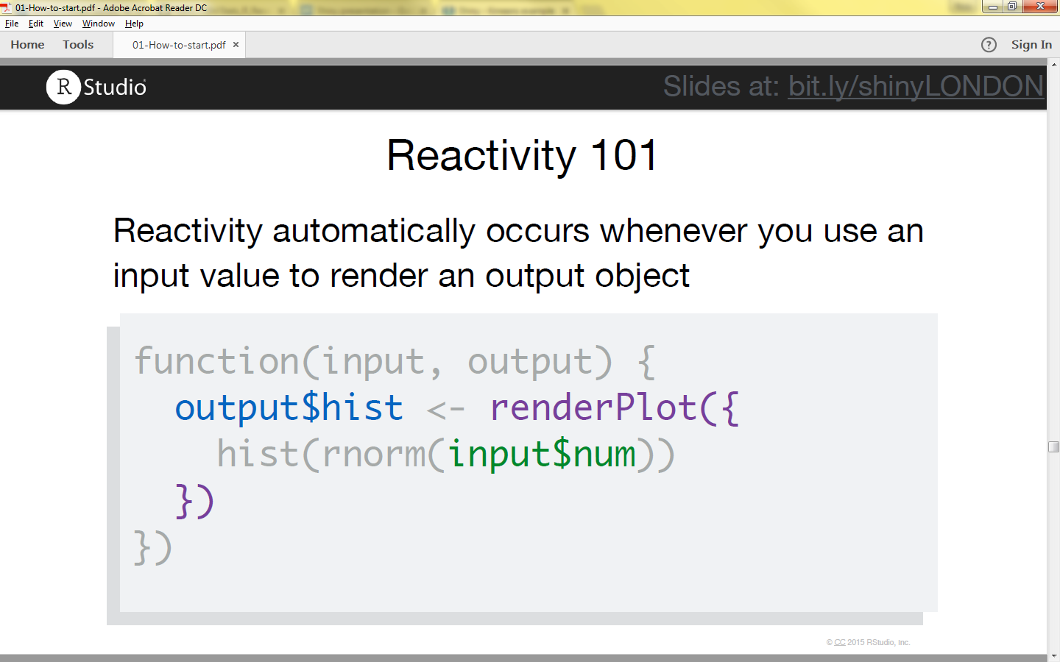
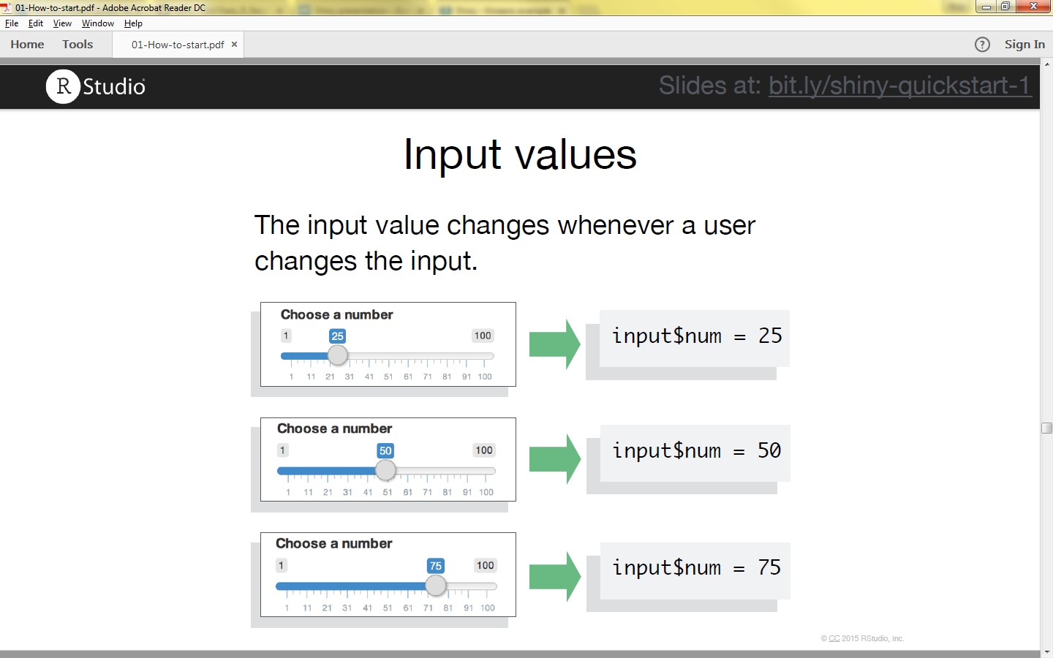
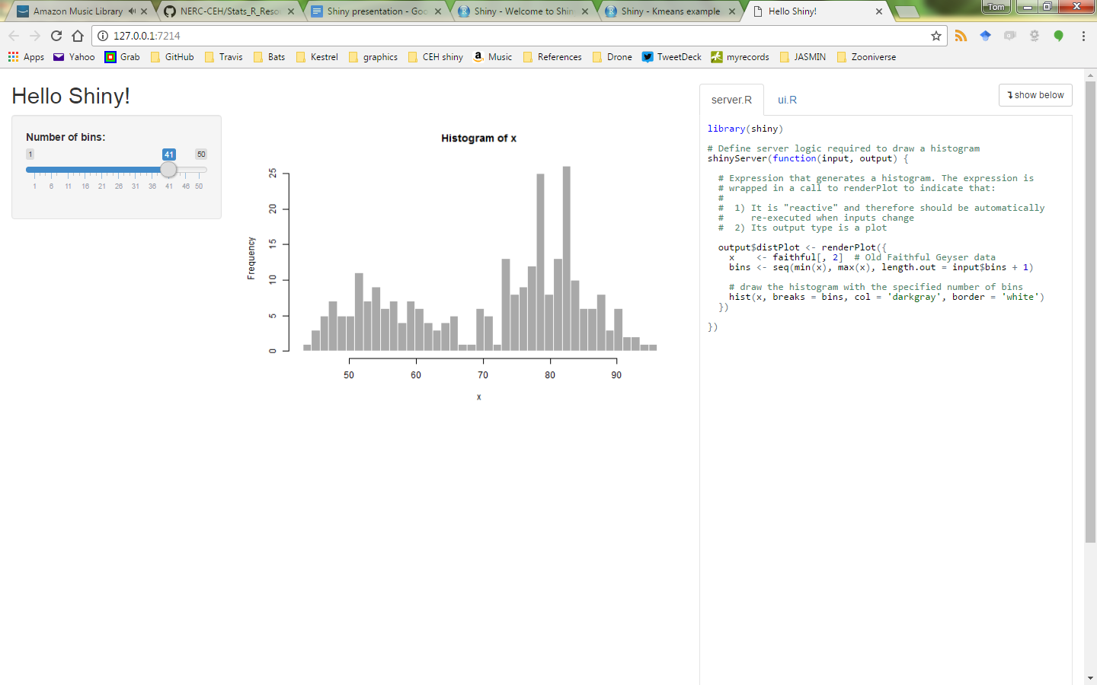
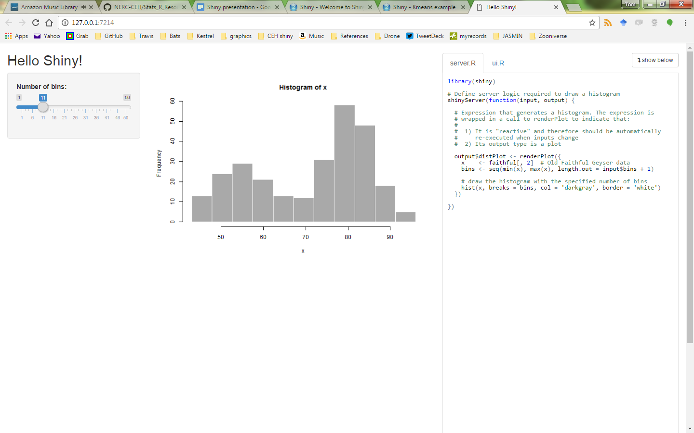
How does it work?

Slide 57
Examples
Shiny Gallery
User inputs define graph http://shiny.rstudio.com/gallery/kmeans-example.html
There are a range of widgets: http://shiny.rstudio.com/gallery/widget-gallery.html
Or with Google charts: http://shiny.rstudio.com/gallery/movie-explorer.html
Maps can be done ++ : http://shiny.rstudio.com/gallery/superzip-example.html

Slide 58
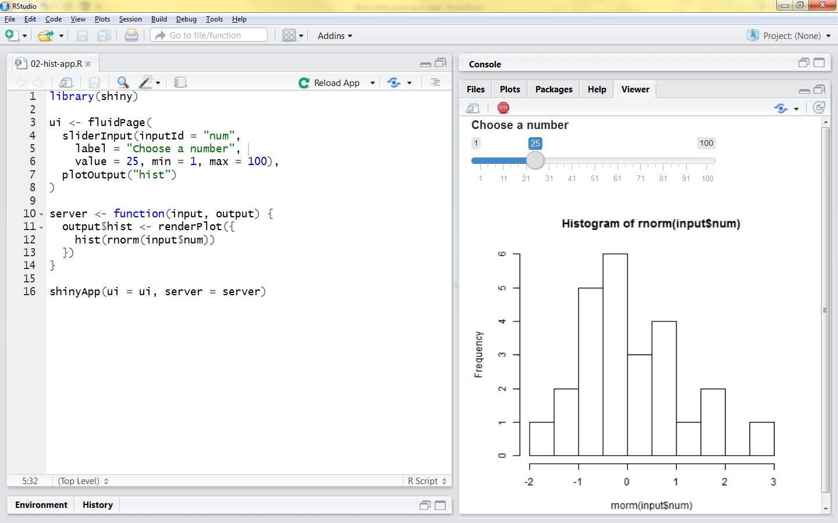
How do I do it?

Slide 59
Cheatsheets

Slide 60

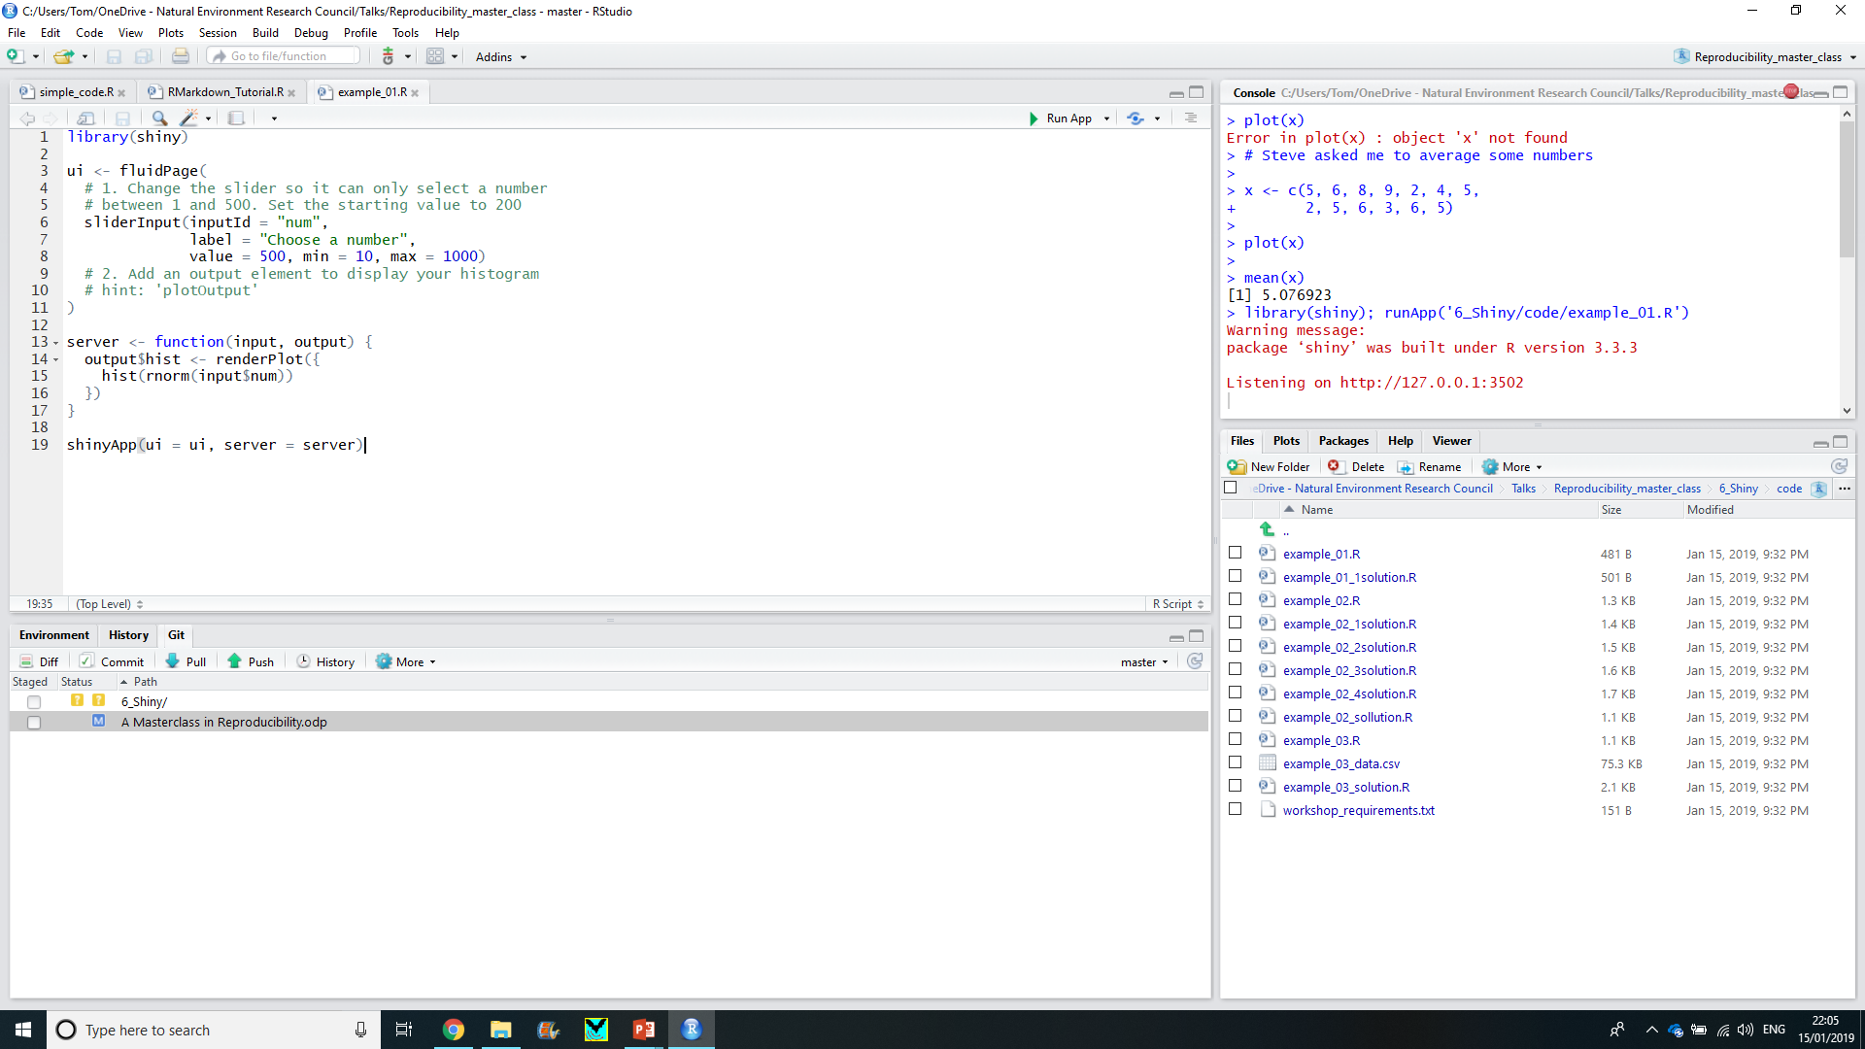
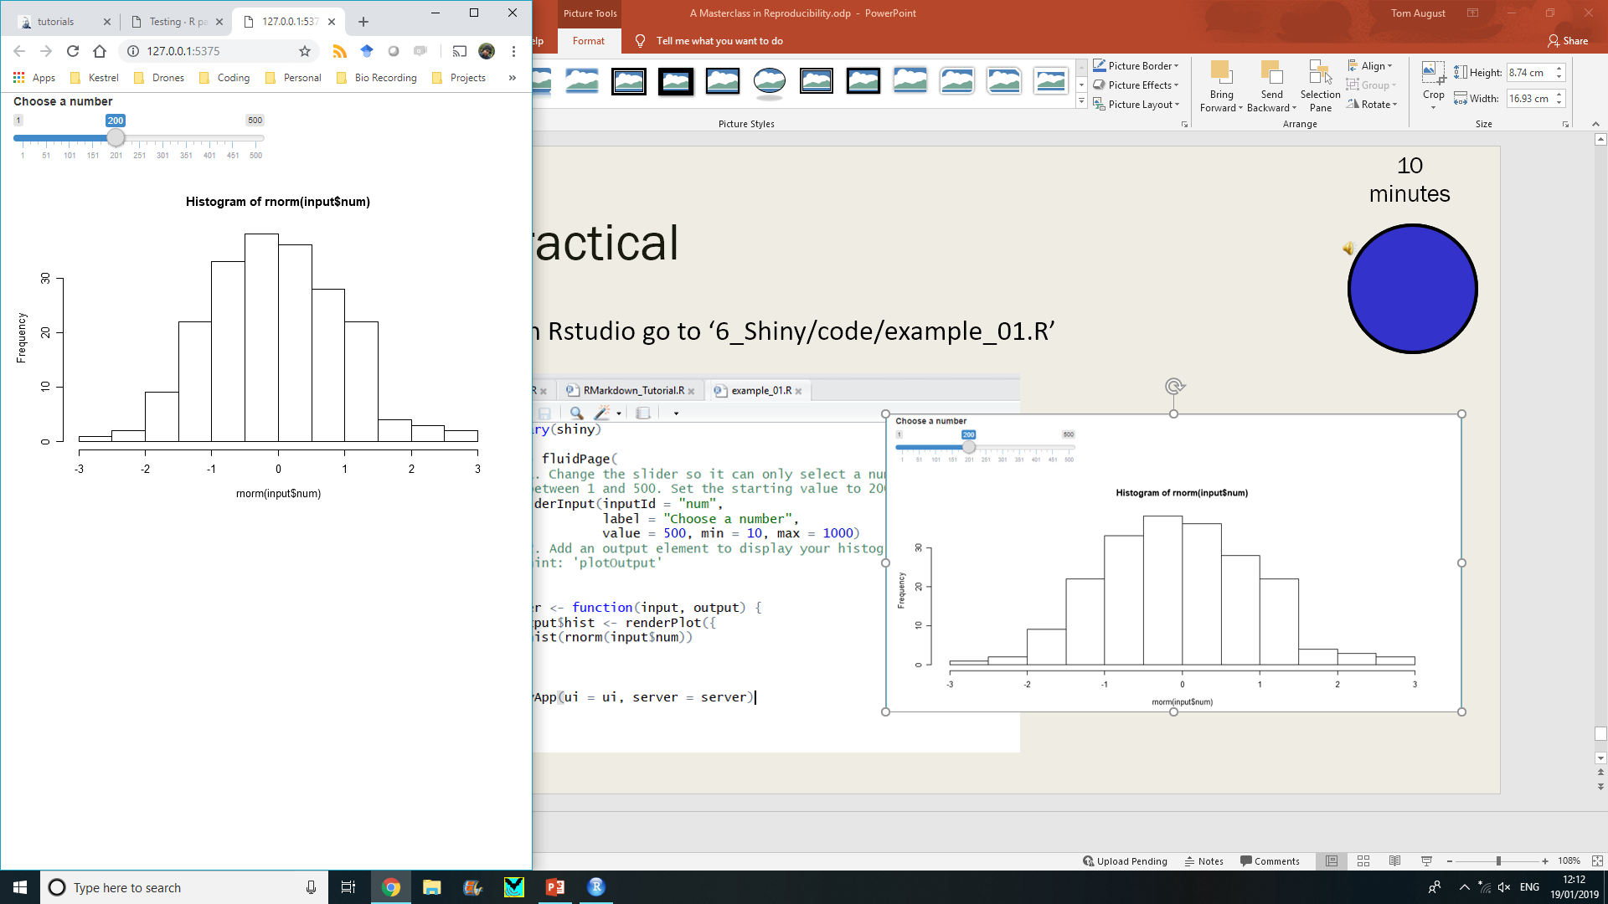
Practical
10 minutes
In Rstudio go to ‘6_Shiny/code/example_01.R’

Slide 61
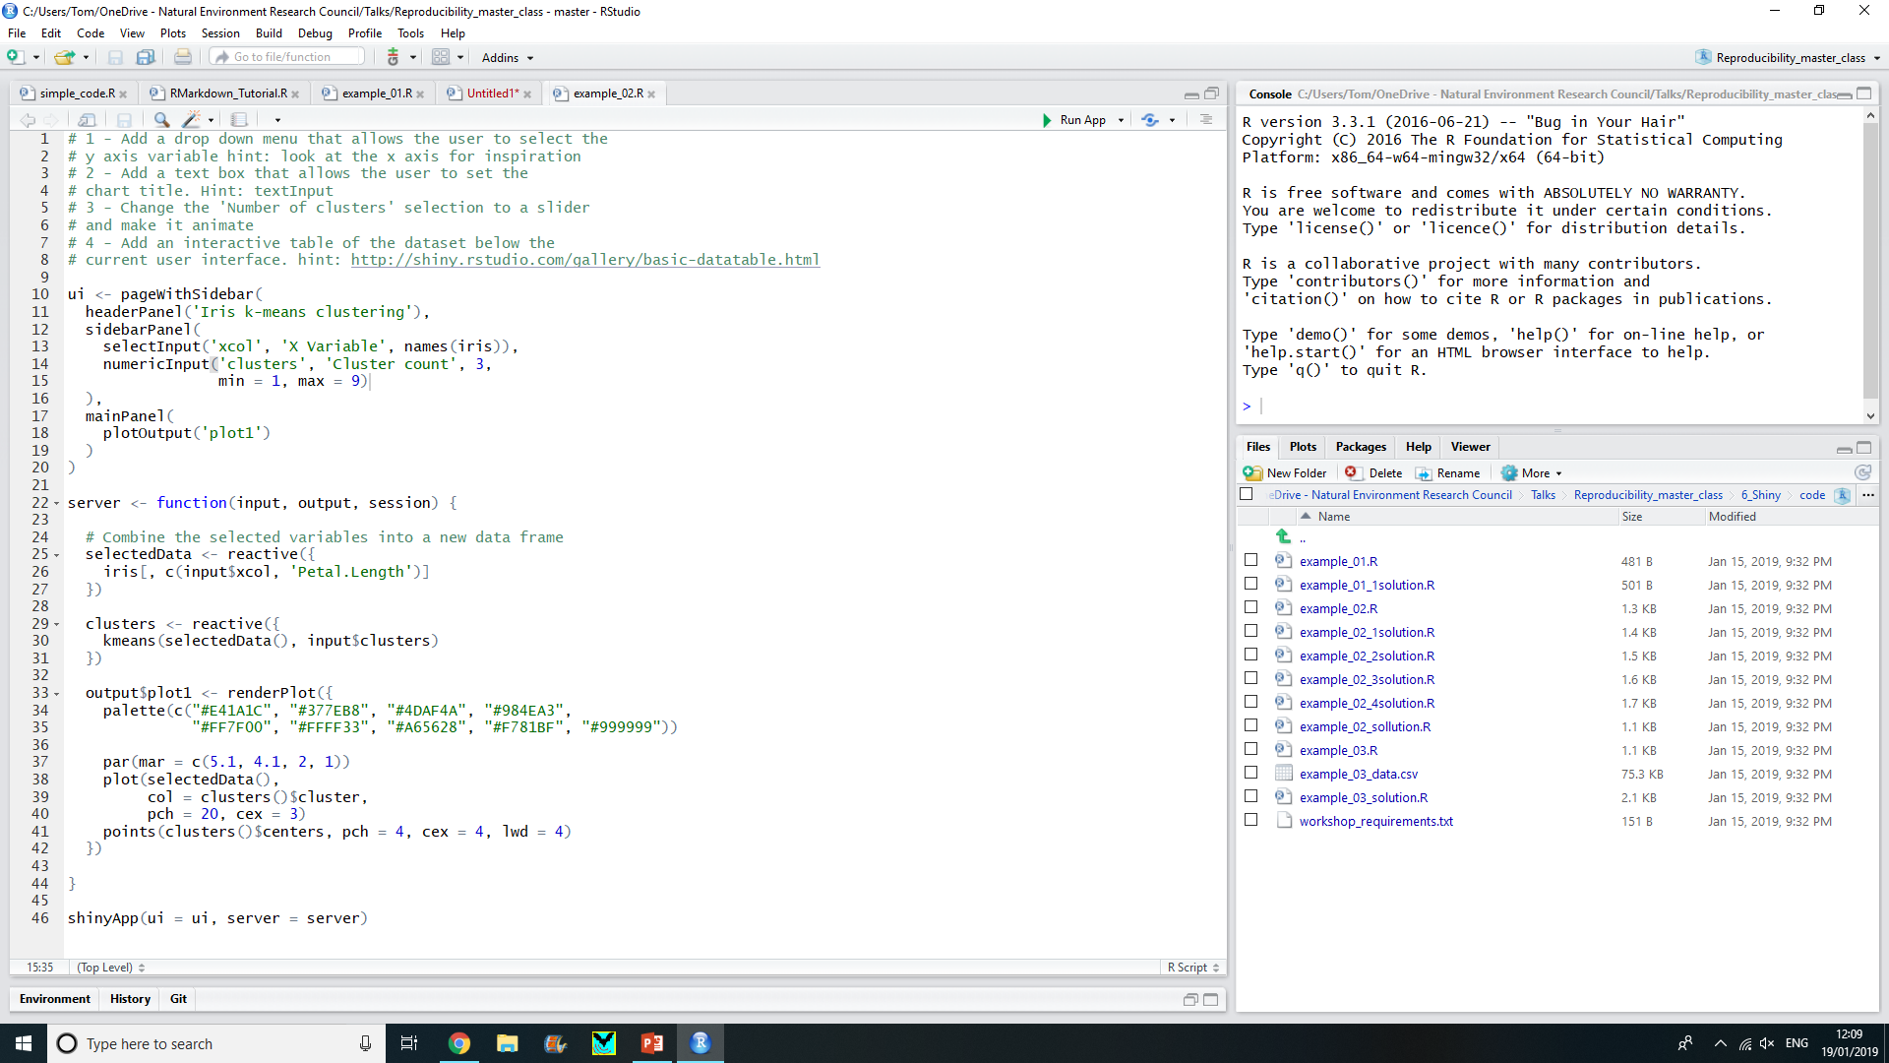
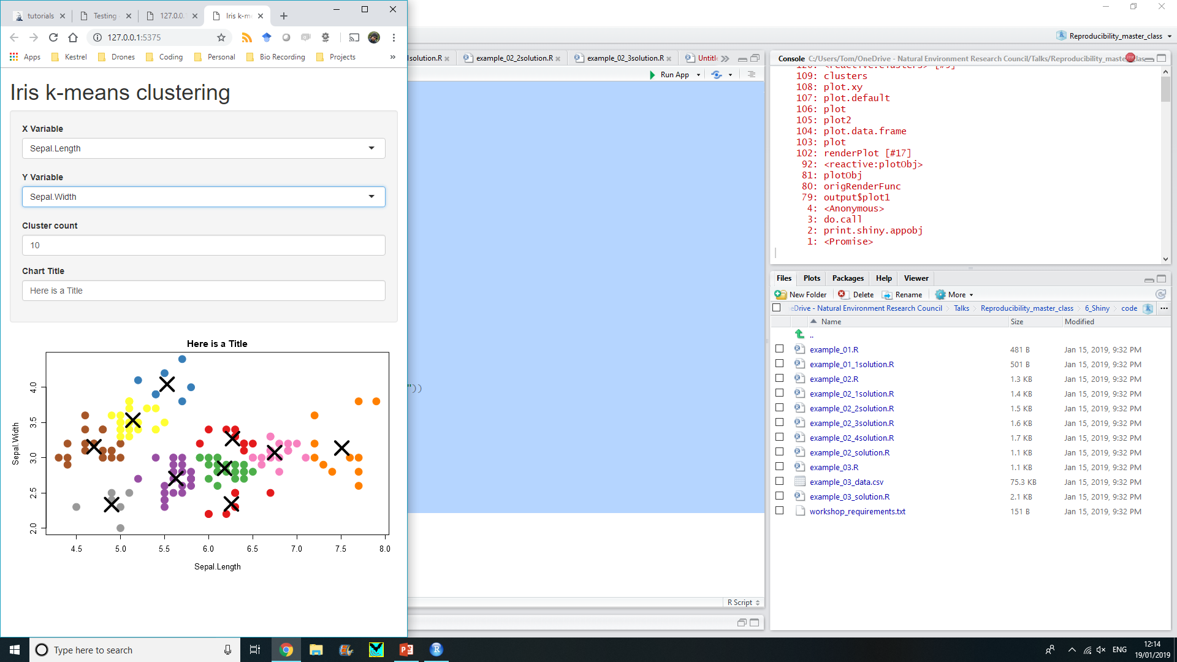
Practical
In Rstudio go to ‘6_Shiny/code/example_02.R’

Slide 62
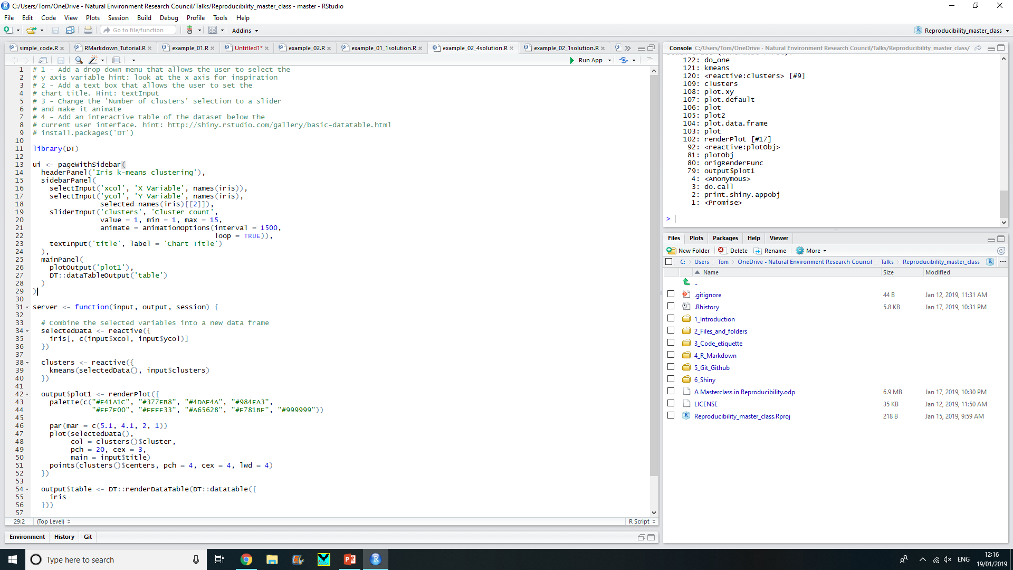
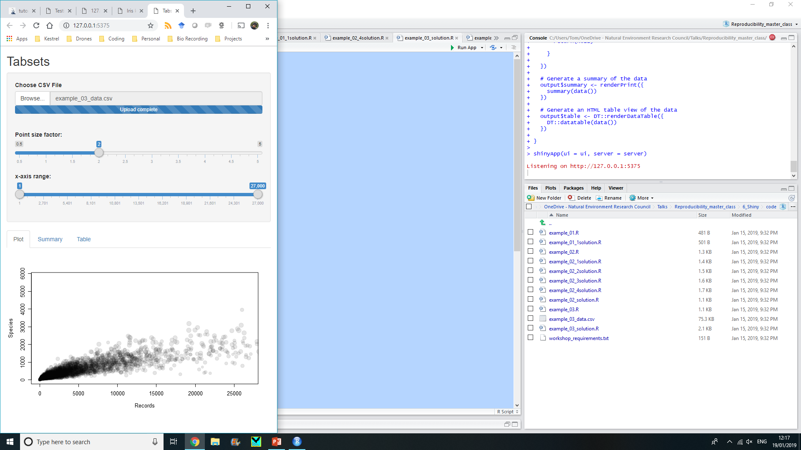
Practical
In Rstudio go to ‘6_Shiny/code/example_03.R’

Slide 63
The internet is FULL of useful information
Karl Broman: https://kbroman.org/
Coding Club: https://ourcodingclub.github.io/
Rstudio tutorials: https://www.rstudio.com/online-learning/
Cheatsheets: https://www.rstudio.com/resources/cheatsheets/
Webinars: https://resources.rstudio.com/
A good book: https://github.com/christophergandrud/Rep-Res-Book
Data carpentry: https://datacarpentry.org/rr-workshop/

